Slide 1
Machine Learning and
Data Analytics for IoT
— KK-FF-WA
COM3505, Lecture 6
Dr Valentin Radu

Slide 2
Assessments: LA1, the mock exam
pls don’t ask us to do the assessment for you! but you can ask us to explain related code from the exercises/ tree, for example ;)
if you’re submitting as a pair, please put a file called pair.txt in your repo, with the format:
person1@sheffield.ac.uk
person2@sheffield.ac.uk
(where person1 owns the git repository that you want me to mark for your team; the file must be duplicated in both team members' repos)
Lab Assessment 1 will be published this Friday (March 15th) for submission on Friday 22nd of March
the mock exam will be available in week 9 or 10
the project specification will be previewed next week for submission in week 12
Reminder of how the assessments work:
LA1 and the exam are pass/fail
you must pass both, and this gives you 40% for the course
the rest of the marks are given on the basis of qualitative assessment of the project (LA2, due end of semester)

Slide 3
[from L7] Projects: Marvin/ESP-Box, unPhone, LilyGoWatch, or…?
options:
the unPhone
Marvin, a DIY Alexa, or ESP-Box/Willow
LilyGoWatch
roll your own (but check first!)
the spin 9 unPhone is an ESP32S3, LCD with touch display, accelerometer, SD card, LoRaWAN, IR LEDs and vibe motor
possible unPhone projects: meshtastic off-grid messaging; remote control of other devices over WiFi or BT, perhaps using a gesture language; voice control via a mic on your other ESP32 (or the expander); exercise tracker; data logger; small-screen UI; fuzzy predictive text; etc. etc. etc.…
with Marvin or ESP-Box and/or the ML that Valentin introduced last week, lots of Alexa-type projects :)
see also Chapter 8

Slide 4
[from L7] Projects: pros and cons
Project | Advantages | Disadvantages
unPhone | all the elements are pre-soldered (unless you use the expander board) there’s a UI! lots of variations possible | it looks like a phone but… isn’t! relies on patched libraries which can make development (even) trickier (v9 better tho)
Marvin or ESP-Box | close to mass-market products like Alexa, Google Home, etc. good online supporting resources | Marvin version needs wiring noise and voice dependent relies on 3rd party services
LilyGO Watch | a wearable! carry a memento of COM3505 everywhere you go! | not a smart watch! translation of docs not perfect
A.N.Other | creativity! | you need to be sure it is A) feasible and B) hard enough

Slide 5
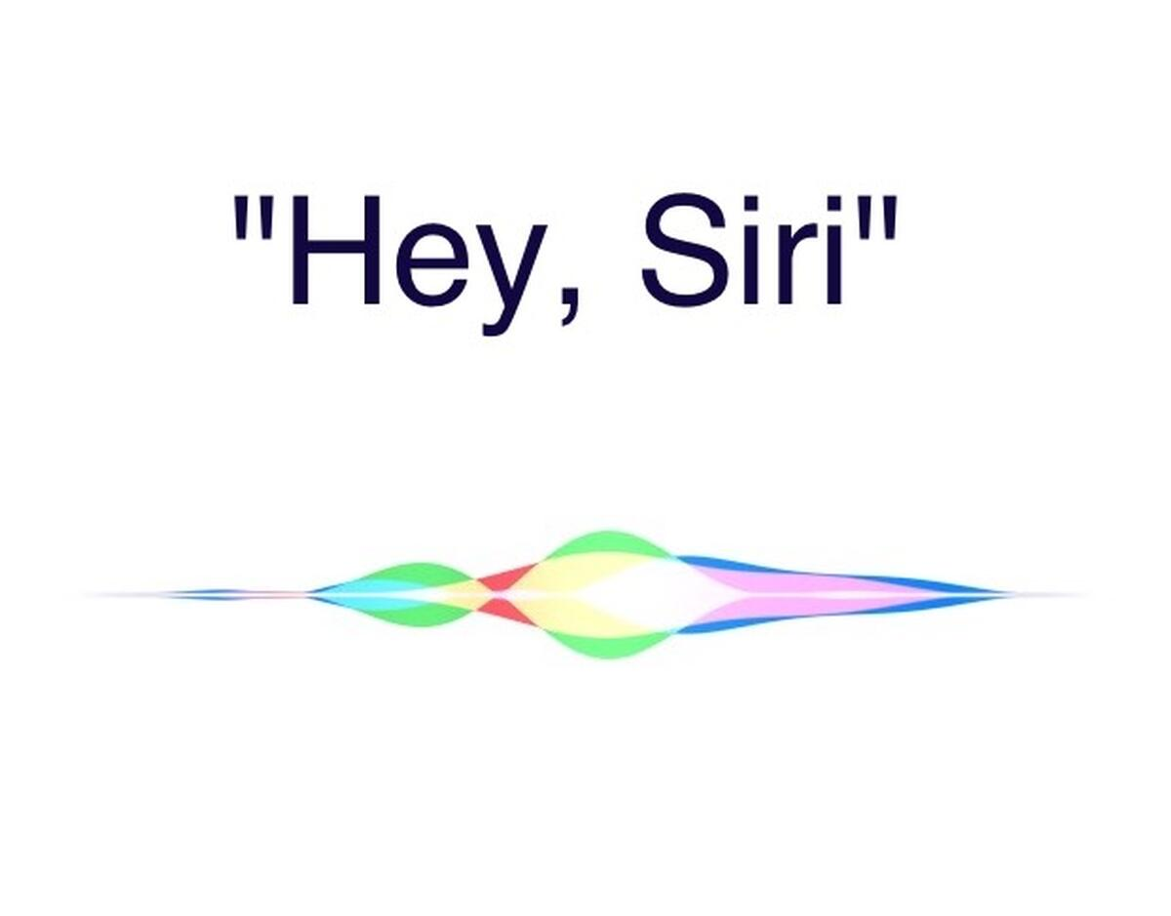
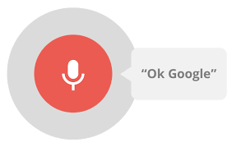
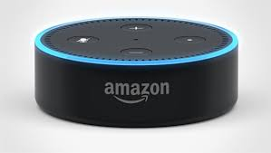
TinyML / ML at the Edge
ML Algorithms
Embedded Systems
TinyML
Notes:
Sits at the intersection of embedded systems (IoT devices) and ML algorithms.
You already take TinyML for granted. When you say Okay Google, Alexa, or Hey Siri. Your voice gets converted into machine signals by algorithms running so efficiently that can continuously listen to your voice until it recognises those keywords.
But that is just the top of the iceberg. TinyML has many useful applications.

Slide 6
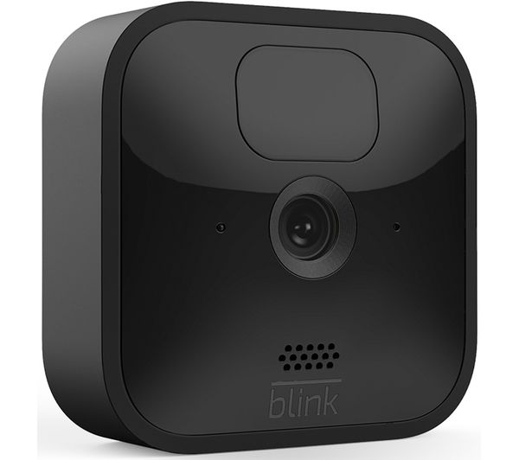
What is Tiny Machine Learning?
Definition: Tiny Machine Learning (TinyML) is a fast-growing field of machine learning technologies and applications
including algorithms, hardware, and software
capable of performing on-device sensor data analytics (vision, audio, IMU, biomedical, etc.)
at extremely low power (milliwatts)
, to enable a variety of always-on machine learning use-cases on battery-powered devices.

Slide 7
Why Running ML at the Edge?
Lower Latency
Avoiding wireless interferences, which make latency unpredictable.
High Availability
Wireless not-spots can be a problem for always-connected devices.
Higher Bandwidth
Large volumes of data can be consumed locally, without being funneled by the network bandwidth
Power efficiency
Radio communication is one of the most energy consuming tasks
Improved Privacy
Medical devices
Home appliances
Notes:
<Interaction> Can anyone tell me why we would want to run ML at the edge?
energy consuming tasks (physically vibrating an antenna to communication bits through the air vs just moving some electrons around in metal and silicon).

Slide 8
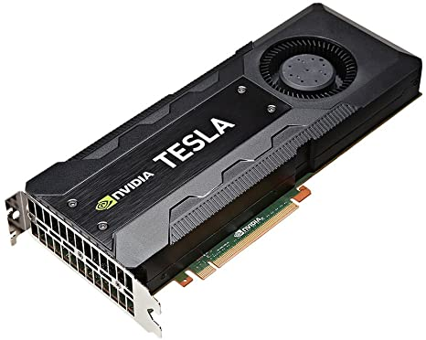
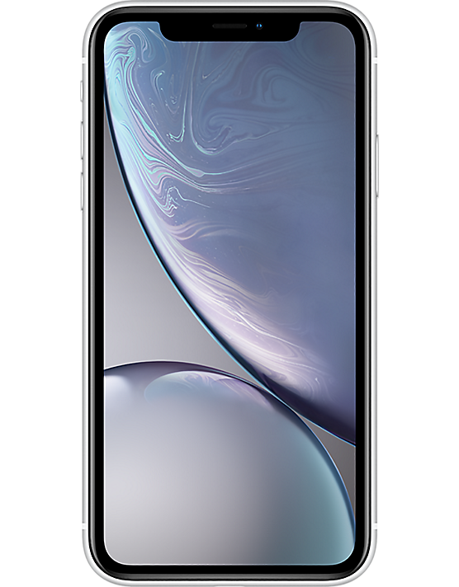
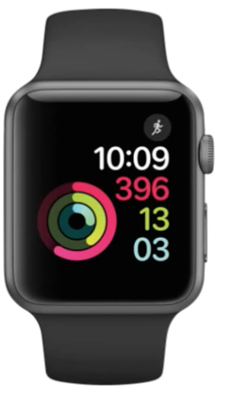
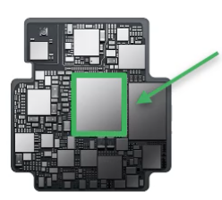
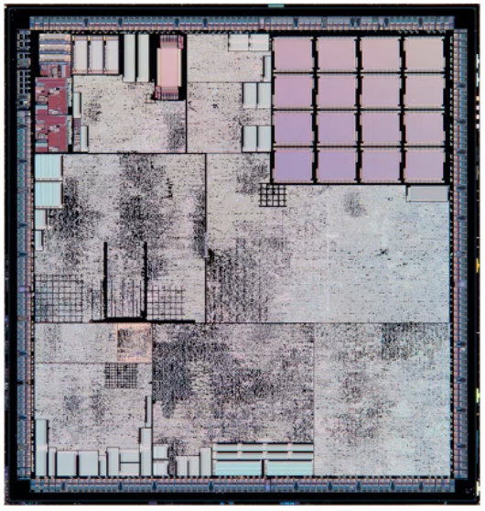
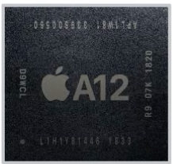
Computing Surface
Computing processors are becoming increasingly smaller.
CPU/GPU
Phone SoC
Watch SoC
Kinetis kl03
Big
561mm²
Small
83mm²
Tiny
30mm²
3.2mm²
300W
Nvidia Tesla K80
3.64W
140µW
Notes:
Big
Small
Tiny
Consume power

Slide 9
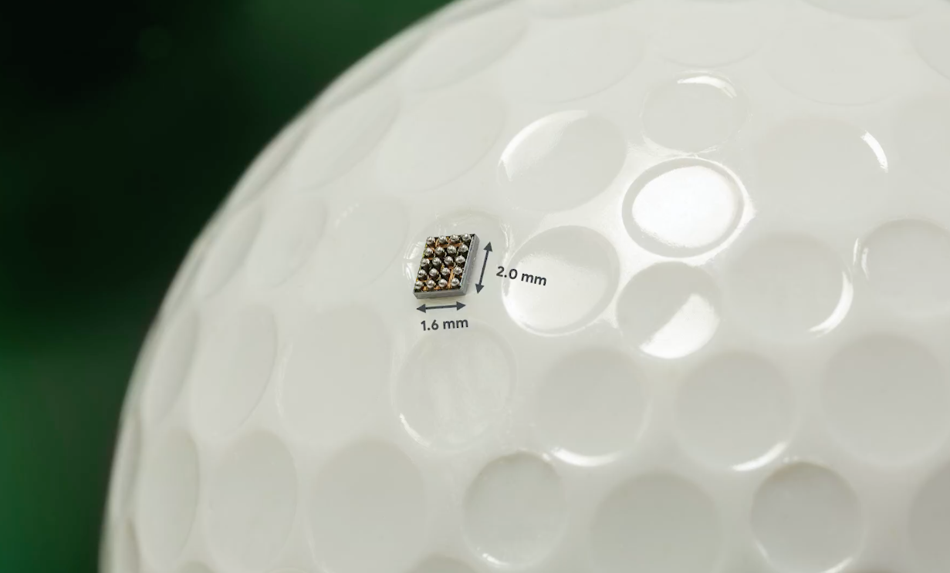
Notes:
The number of devices is currently in the billions and we are expecting to reach the trillion mark of small computing devices. They are ubiquitous and they will continue to be introduced in more and more devices.

Slide 10
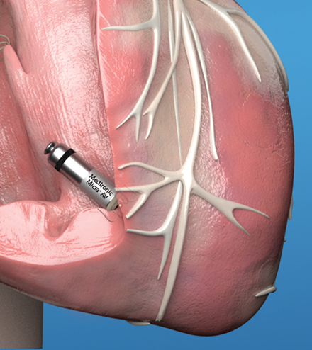
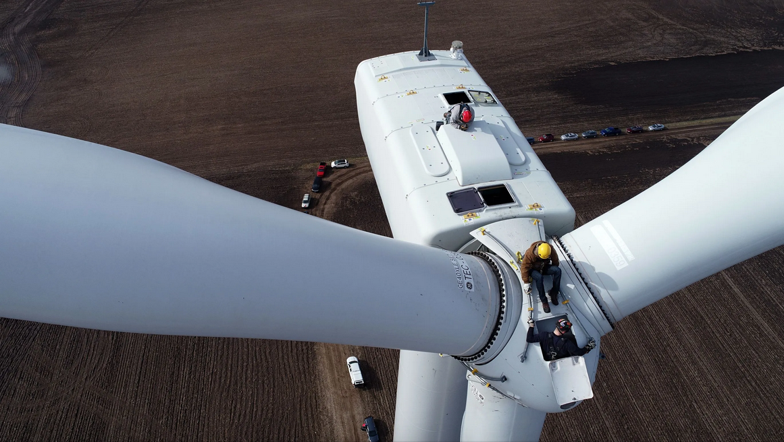
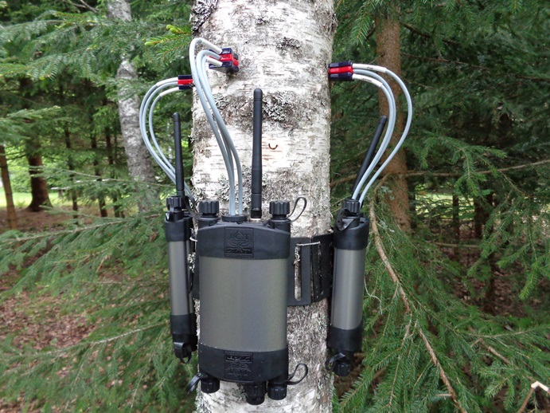
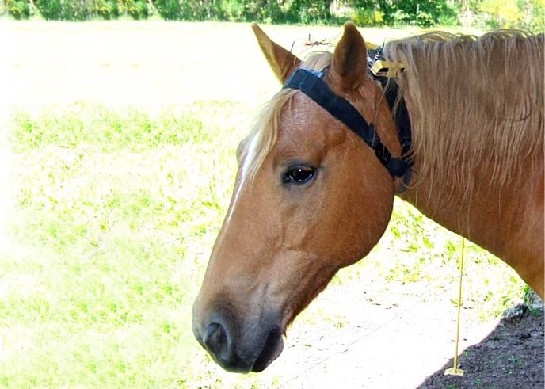
Applications
Monitoring equipment performance for maintenance
Vibration patterns can indicate when an equipment requires maintenance
Healthcare
Smart pacemakers
The Solar Scare Mosquito project
Agriculture
Detecting diseases in plants just by taking a picture
Soil humidity monitoring
Wildlife conservation
Notes:
Machines are prone to failures. Early detection of failures will give enough time to order the spare parts and service the equipment with minimal stall to the production line. This predictive maintenance can lead to significant cost savings for wind turbines for instance.
Ping Services, an Australian startup, introduced the IoT device that autonomously monitors wind turbines by magnetically attaching to the outside of the turbine and analyzing detailed data at the edge.
Amazon with their AWS have an integrated service just for this task - Amazon Monitron Sensors. They still rely on the cloud for ML analysis.
The Solar Scare Mosquito project uses TinyML to curb the spread of mosquito-borne diseases like Dengue, Malaria, Zika Virus, Chikungunya, etc. It works by detecting the mosquito breeding conditions and agitates the water to prevent mosquito breeding. It runs on solar power and can thus run indefinitely.
Medtronic Micra - Adjusts your heart rate automatically, by sensing changes in your body related to your activity level and adjusting your heart rate accordingly.
Any device that you can think of can be enabled with sensors to generate some sort of data and with ML you can make decisions locally. Can you think of any other applications that we could see in the future? 2 minutes to generate some ideas.

Slide 11
Sensor technology is advancing fast.
Computing devices are becoming very small and cheap (< £1).
These can operate on battery power for a long time.
Any device can become smart; Many integrated devices build smarter applications.
3 minutes to think about some future application with smart devices:
https://jamboard.google.com/d/1u1M35eNfZmHlMnArzAEAJEyDhuMJ7vR4jb0ZbofiWq0/edit?usp=sharing
Notes:
https://jamboard.google.com/d/1u1M35eNfZmHlMnArzAEAJEyDhuMJ7vR4jb0ZbofiWq0/edit?usp=sharing

Slide 12
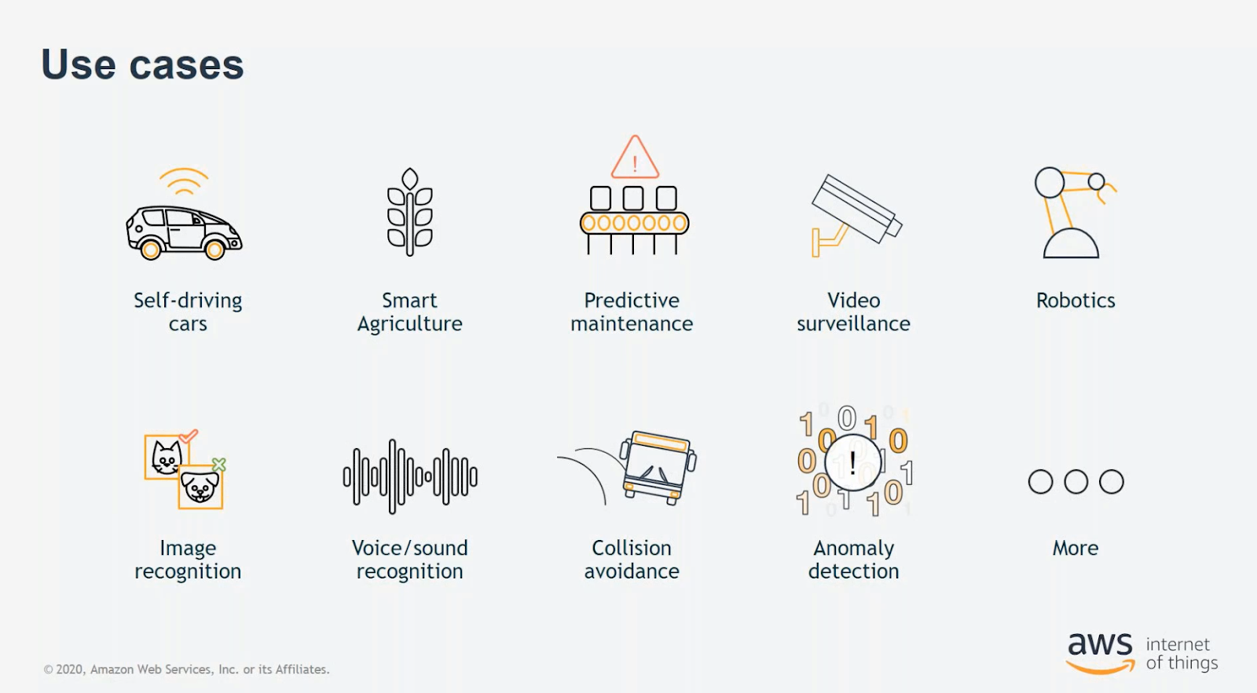
Cloud Solutions

Slide 13
Cloud Services
Amazon Web Services (AWS)
Microsoft Azure
Google

Slide 14
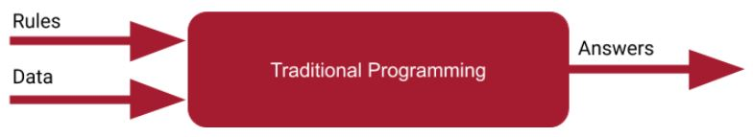
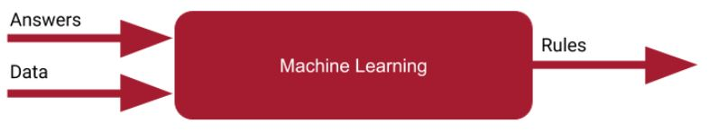
The ML paradigm
In traditional programming, the rule is set by the programmer. In ML, the rule is learned from a large set of expert annotated data.

Slide 15

Training - Inference
Steps in building a ML model:
Data collection
Data sanitation and pre-processing
Data analytics
Training
Test
Deployment
on-device
in the cloud
on-device
Notes:
energy consuming tasks (physically vibrating an antenna to communication bits through the air vs just moving some electrons around in metal and silicon).

Slide 16
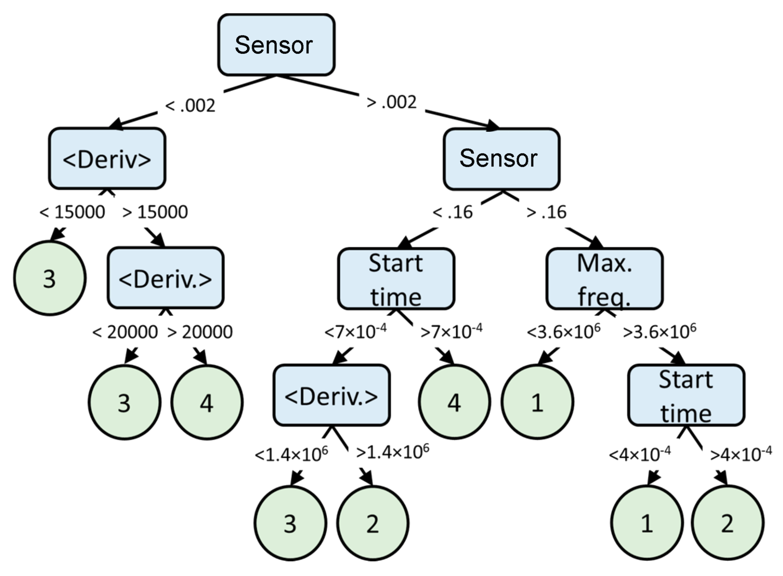
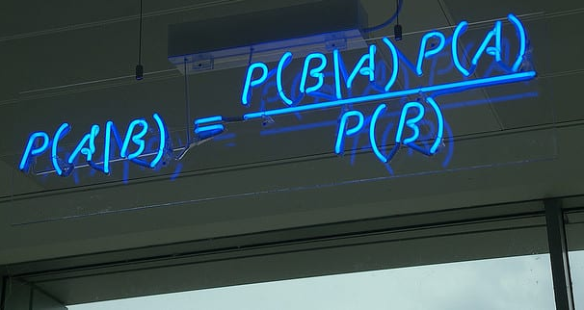
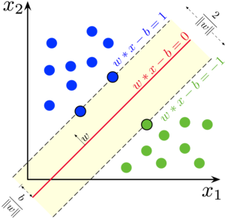
Common ML Algorithms
Traditional ML
Classifiers (Sklearn):
Decision Tree classifiers
Random Forest classifiers
Nearest Neighbour classifiers
Bayesian Classifiers (Naive Bayes, Bayesian Nets)
Support Vector Machine (SVM) classifiers
Regression
Logistic regression
Clustering
k-Means
DBSCAN
Deep learning
Convolutional Neural Networks (CNN)
Recurrent Neural Networks (RNN)
Generative Adversarial Networks (GAN)
Notes:
Complex tasks such as image classification, image segmentation, on images or audio recognition require more robust classification methods. Deep learning can bridge that complexity.

Slide 18
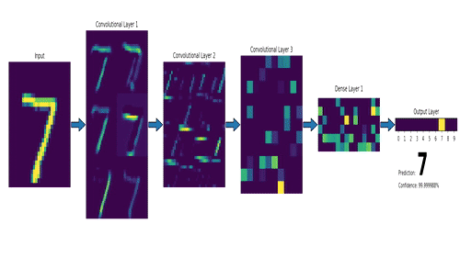
Feature Extraction
Traditional ML
Hand-engineered features (edges, corners, edge direction, interpoint distance, etc.)
Deep Learning:
Features are automatically extracted during training

Slide 19
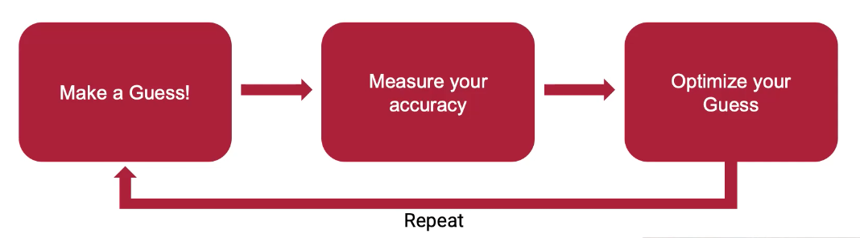
Training
On-device training is hard
Not enough resources (computation and energy).
We will look into Federated Learning as one example of training enabled at the edge in a next lecture.
The ML paradigm:
Data

Slide 20

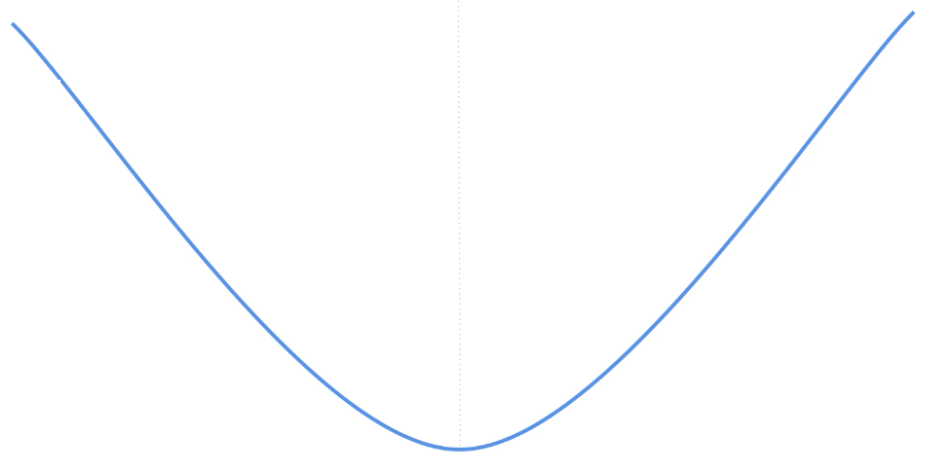
Training with Gradient Descent
Given {(x₁, y₁), ..., (x_{n}, y_{n})}, want f_{θ}(x_{i}) ~ y_{i}
Loss function:
Minimising the loss function
Loss function
Gradient of
parameter value
The step is determined by the learning rate.
Minimum of loss function
Notes:
The parameters determine the current solution.

Slide 21
Research Challenges for Edge AI
Hard to do - it’s a hot research area
Proposed solutions: neural network pruning
Data access
Access patterns - read/writes
No cache in microcontrollers
Accelerating operations
There are more than 100 different implementations known for the operation of a Conv layer. Each layer configuration has different performance on a target device.
Compiler driven optimisations by iterating over the instruction set to find the best selection and order of instruction for the higher level operation.
Notes:
energy consuming tasks (physically vibrating an antenna to communication bits through the air vs just moving some electrons around in metal and silicon).

Slide 22
Recap
Sensing technology is advancing fast.
There are advantages to consuming data at the edge:
Privacy and security
Lower latency
High availability
High bandwidth
Energy efficiency
Traditional classifiers vs deep neural networks
Gradient descent is a common method for training neural network models.

Slide 23
Model Compression Solutions
Reducing the size of a large neural network to make it accessible for smaller devices by:
Quantization
Pruning
Knowledge distillation

Slide 24
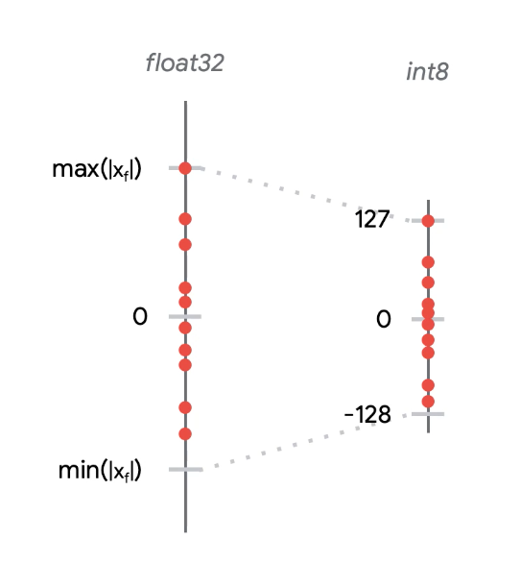
Model Quantization
The interval of values taken by the network parameters in floating point, is mapped to a discrete interval of int values:
Linear
Logarithmic
Density based

Slide 25
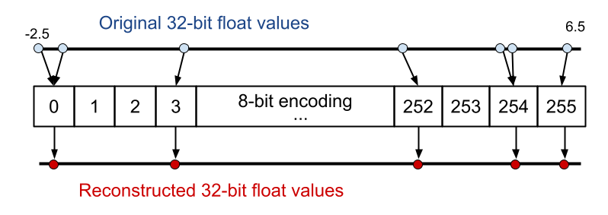
Model Quantization
Linear mapping

Slide 26
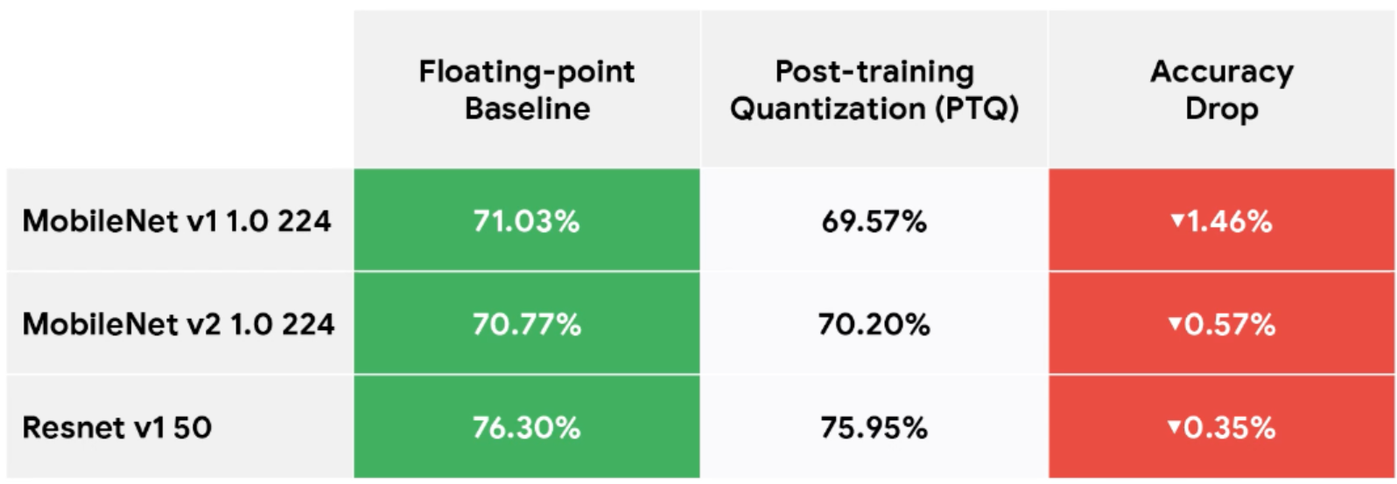
Loss of Accuracy with Quantization
Slight drop of inference accuracy due to loss of precision in information propagation across layers - post-training quantization (PTQ).
Training the model with quantization-aware methods can improve the accuracy of PTQ. Still in the research space [read: Quantization and Training of Neural Networks for Efficient Integer-Arithmetic-Only Inference]
Notes:
It simulates quantization effects in the forward pass of training. Backpropagation still happens as usual, and all weights and biases are stored in floating point so that they can be easily nudged by small amounts.

Slide 27
Advantages of Quantization
Model size: networks can take up to 4 times less memory in 8-bit representation vs the 32-bit ones.
Reducing Inference Latency: with vectorised operations, the models can be a lot faster.
Portability: not all microcontrollers can run 32-bit fp operations, so quantized models may be their only option

Slide 28
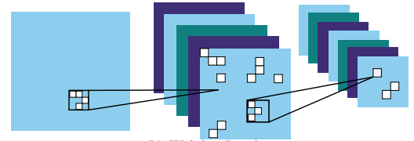
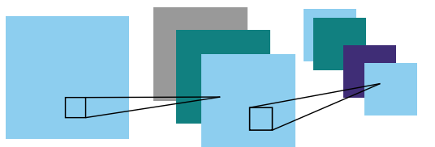
Model Pruning
Many parameters in large neural networks are redundant. They are important during training (regularisation with Dropout), but wasteful during the inference stage.
Weight pruning - parameters with a value very close to zero are reduced to 0.
Channel pruning - entire filters are eliminated from the convolutional layer.
The pruned model almost always has a lower accuracy than the original model even after refining this with additional training.

Slide 29
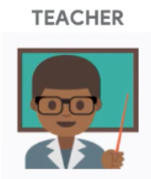
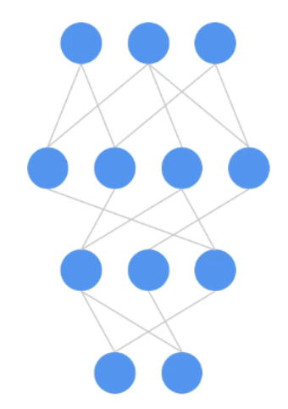

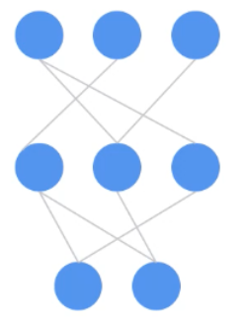
Knowledge Distillation
Using a teacher-student setting:
The teacher is a larger network that was trained over many epochs.
The student is a smaller network that receives guidance from the teacher network during its training.
Data
Data
Forcing the student output to match the teacher’s output
[Distilling the Knowledge in a Neural Network]

Slide 30
Knowledge Distillation
Advantages:
Student models are much smaller so they can run efficiently on smaller devices.
Students train much faster with the insights from the teacher network.
Disadvantages:
Loss of accuracy (the student accuracy is slightly lower than that of the teacher).
It is hard to come up with a good model architecture for the student network:
Too small and the student doesn’t learn much
Too large and the efficiency gains are lost.

Slide 31
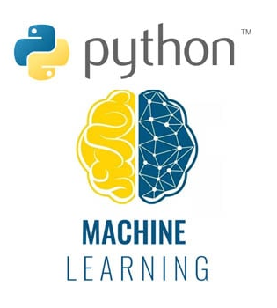
Why Python for ML?
IoT mostly programmed in C/C++
Data scientists don’t always have a CS background
Python is a simple language to learn
Very good ML libraries (numpy, scipy, pytorch, keras, theano, sklearn) and visualisation libraries (matplot).
Extensively used in industry.
Python for IoT -> microPython (pycom API)
Notes:
Numpy - python library for large multi-dimensional array and matrix processing and math functions (linear algebra, Fourier transform, and random number capabilities). Used by other higher level libraries like tensorflow for tensor manipulation.
Scipy - contains different modules for optimization, linear algebra, integration and statistics, image manipulation,
Sk-learn - supports most of the supervised (decision tree, bayesian classifiers, and even neural networks) and unsupervised learning algorithms. Uses numpy and scipy libraries for efficient manipulation of data. This is also used for data mining and data analytics (plotting your data distribution, skewness, dimensionality reduction).
Theano - used to define, evaluate and optimize mathematical expressions involving multi-dimensional arrays in an efficient manner. It is achieved by optimizing the utilization of CPU and GPU.
Pytorch - an open source ML framework optimised for deep neural networks (a large number of layer types). Not many people know that it is actually implemented in C, that’s why it is so efficient in performing very large matrix multiplications.

Slide 32
Summary
Computations are moving closer to the data source. Billions of small devices will be processing data at the edge of the Internet.
Reduced cost for edge computing, low energy consumption and advancing sensor technology is enabling ubiquitous smart devices and applications.
Commonly, we train ML models in the cloud and run them at the edge (on-devices).
Edge inference provides: lower latency, high availability, high bandwidth, power efficiency, privacy.
Neural network compression methods (quantization, pruning, knowledge distillation) enable large ML models to run at the edge.

Slide 33
Questions
Questions
Demo: Spoken keyword spotting
https://colab.research.google.com/github/tinyMLx/colabs/blob/master/3-5-18-TrainingKeywordSpotting.ipynb
Notes:
energy consuming tasks (physically vibrating an antenna to communication bits through the air vs just moving some electrons around in metal and silicon).

Slide 34
Your TODO list for week 6:
Make sure you did Ex09 and Ex10, including the touch sensing part
Prepare for LA1 (published Friday, submit before Easter)
Chapter 6: ML; IFTTT
Make sure you understood the notes and lecture

